Slide 1

Houston, TX
2019
#XamDevSummit

Slide 2


Slide 3
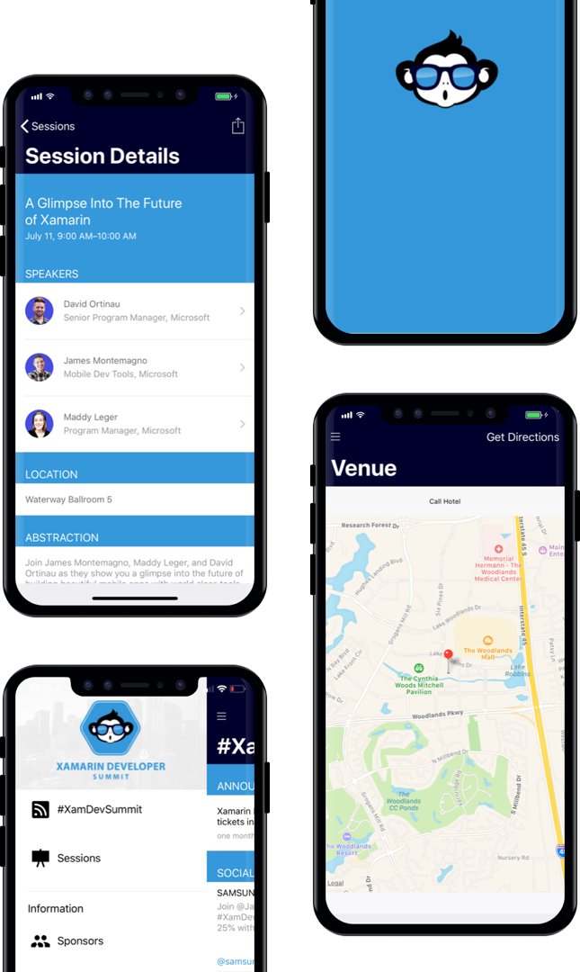
AGENDA
Download our Xamarin based mobile app: XamDevSummit.

Slide 4
Unit Testing Prism Apps With Ease
skip the ceremony and get straight to testing
Duane Newman
Alien Arc Technologies, LLC
@DuaneNewman

Slide 5
Common Unit Testing Challenges
Calling APIs
Injecting Dependencies
Instantiating Objects
Notes:
3 major concerns
Working with APIs
API might not be written/usable
Using a live API requires valid data in tests
Failure conditions can be difficult to control
May require large amount of live data to provide all scenarios
Ignoring issues with database access, because in the mobile world, that is usually sitting behind our API.
Working with Dependencies
Hard to control behavior
Cumbersome when dependencies have dependencies
Difficult to confirm usage
Usually requires your test to also know what the dependency *should* do
Keep minimal concern/single responsibility
Tests should be able to focus on the individual unit being tested working correctly, not the entire dependency stack
Instantiating Objects for testing
“new” in tests can become brittle with constructor signature changes
Creating entire dependency chain
Dependencies with dependencies get messy
Constructor signature changes on dependencies break even more code
Unnecessary: You don’t do it in your app, why do it in your tests?
Constructor changes don’t just break tests, they break code (now have to go everywhere that constructor is called and fix the code before tests can be ran to see if anything was broken)

Slide 6
APIs… Without an API

Slide 7
Faking the API Server
HttpMessageHandler
RichardSzalay.MockHttp
Notes:
HttpMessageHandler
Used by HttpClient to handle… HTTP Messages
Is given a HttpRequestMessage
Returns a HttpResponseMessage
Default implementation for HttpClient is HttpClientHandler
Can supply a custom implementation to HttpClient
RichardSzalay.MockHttp
Provides a custom HttpMessageHandler
Allows you to process incoming HttpRequest and specify a return HttpResponse
Can be configured with expected requests that must arrive in order
Can be configured with generic definitions that match when no explicit expectations are present
Allows you to mock up an entire API
Can be used for canned responses
Can be used to provide dynamic functionality (such as a POST updating a list that is returned from a GET)

Slide 8
// static response
mockHttp.When("http://localhost/api/user/*")
.Respond("application/json", "{'name' : 'Test McGee'}");
// dynamic response
mockHttp.Expect("http://localhost/api/user/*")
.Respond(request =>
{
var id = request.RequestUri.Segments.Last();
return new HttpResponseMessage(HttpStatusCode.OK)
{
Content = new StringContent(
$"{{‘id’ : ‘{id}’, 'name' : 'Test McGee’}}",
Encoding.UTF8, "application/json")
};
});
http://localhost/api/user/1234
Notes:
What’s happening:
* (asterisk) matches any content past this point
Second call uses request message to get details about the request

Slide 9
public interface IHttpMessageHandlerFactory
{
HttpMessageHandler GetHttpMessageHandler();
}
public class HttpClientMessageHandlerFactory : IHttpMessageHandlerFactory
{
public HttpMessageHandler GetHttpMessageHandler()
{
return new HttpClientHandler();
}
}
public class MyService
{
public MyService(IHttpMessageHandlerFactory messageHandlerFactory)
{
var client = new HttpClient(messageHandlerFactory.GetHttpMessageHandler());
}
}
Notes:
Making it Easier to Use
What’s happening:
* (asterisk) matches any content past this point
Second call uses request message to get details about the request

Slide 10
Bonus Uses for MockHttp
Can be run in live app on device/emulator
Test runtime behavior/layout with controlled data (before the API is available)
Use with automated UI testing to ensure consistent test behavior
Provide a demo build that acts exactly the way you want it to
Notes:
Can be included in your app build and used on device
Run your App to tweak UI before the API is available
Use with automated UI testing to ensure consistency
Provide a demo build that acts exactly the way you want it to
Mock out new behavior without spending time on the API/backend to see if it meets user expectations

Slide 11
Dependencies… Without Dependencies

Slide 12
Mocking
Testing one thing, not the things it relies on
Provide an expected behavior to validate test
Can be manually created test classes implementing interfaces
Or… using something easier.

Slide 13
Moq
Provides fluent syntax
Can…
Mock Interfaces and Classes
access mock from “object” reference
Provides…
Robust Setup configuration to match calls
Ability to return either static results, or dynamic (based on input)
Is strong-typed/type-safe and works with refactoring tools
Allows you to change expectations/behaviors on the go

Slide 14
var mock = new Mock<ICartRepository>();
mock.Setup(r => r.ClearAllProducts())
.Returns(Task.FromResult(new CartProduct[0]));
mock.Setup(r => r.GetProducts())
.Returns(() =>
Task.FromResult(Cart.ToArray()));
mock.Setup(r => r.UpdateProduct(It.IsAny<CartProduct>()))
.Returns<CartProduct>(p => Task.FromResult(p));
Notes:
Setup Expected Behavior

Slide 15
mock.Verify(s => s.DisplayAlertAsync(
"Cart Error",
"We were unable to add the item to your cart",
"Ok"),
Times.Once);
Notes:
Demo, with SetupSequence

Slide 16
NEW… Without new()

Slide 17
My TDD Journey with Xamarin Forms

Slide 18
var navService = new Mock<INavigationService>();
var mockEventAggregator = new Mock<IEventAggregator>();
mockEventAggregator.Setup(a => a.GetEvent<EditProjectLoadedEvent>())
.Returns(() => new Mock<EditProjectLoadedEvent>().Object);
var vm = new ProjectEditorPageViewModel(
navSevice.Object,
mockEventAggregator.Object);
vm.LoadProject(1);
mockEventAggregator.Verify(m => m.GetEvent<EditProjectLoadedEvent>(), Times.Once);
Notes:
Started Mocking

Slide 19
void Mock<INavigationService> GetDefaultMockINavigationService()
{
var navService = new Mock<INavigationService>();
return navService;
}
void Mock<IEventAggregator> GetDefaultMockIEventAggregator()
{
var mockEventAggregator = new Mock<IEventAggregator>();
mockEventAggregator.Setup(a => a.GetEvent<EditProjectLoadedEvent>())
.Returns(() => new Mock<EditProjectLoadedEvent>().Object);
return mockEventAggregator;
}
void Mock<IFileViewerService> GetDefaultMockIFileViewerService()
{
var mockFileViewerService = new Mock<IFileViewerService>();
return mockFileViewerService;
}
Notes:
Refactored when I added a new dependency

Slide 20
var mockEventAggregator = GetDefaultMockIEventAggregator();
var vm = new ProjectEditorPageViewModel(
GetDefaultMockINavigationService().Object,
mockEventAggregator.Object,
GetDefaultMockIFileViewerService().Object);
vm.LoadProject(1);
mockEventAggregator.Verify(m =>
m.GetEvent<EditProjectLoadedEvent>(), Times.Once);
Notes:
Refactored when I added a new dependency

Slide 21
ProjectEditorPageViewModel GetProjectEditorPageViewModel(
INavigationService navigationService = null,
IEventAggregator eventAggregator = null,
IFileViewerService fileViewerService = null)
{
return new ProjectEditorPageViewModel(
(navigationService ?? GetDefaultMockINavigationService()).Object,
(eventAggregator ?? GetDefaultMockIEventAggregator()).Object,
(fileViewerService ?? GetDefaultMockIFileViewerService()).Object);
}

Slide 22
var mockEventAggregator = GetDefaultMockIEventAggregator();
var vm = GetProjectEditorPageViewModel(
eventAggregator: mockEventAggregator.Object);
vm.LoadProject(1);
mockEventAggregator.Verify(m =>
m.GetEvent<EditProjectLoadedEvent>(), Times.Once);

Slide 23
There Has to be a better way
Oh yeah, we are already using an IoC container

Slide 24
public class OrderRepositoryTest : TestBase
{
private Action<Mock<IOrderService>> OnOrderServiceMockCreation = mock =>
{
mock.Setup(s => s.GetOrders()).Returns(new List<Order>());
});
public class OrderRepositoryTest()
{
RegisterMockType(() => OnOrderServiceMockCreation);
}
[Test]
public void CallingOrderRepositoryGetOrdersCallsOrderServiceGetOrdersOnce()
{
var repo = ResolveType<OrderViewRepository>();
repo.GetOrders();
ValidateMock<IOrderService>(mock =>
{
mock.Verify(s => s.GetOrders(), Times.Once);
});
}
}

Slide 25
Making it Portable
And Sharing it with You!

Slide 26
Ease Library
Built on popular OSS libraries
NUnit
Moq
IoC container support
Unity
DryIoc
Prism.Forms integration
Notes:
Embraces IoC and Mocking and makes registering and managing mocks easy

Slide 27
Simplifies Managing Mocked Dependencies

Slide 28
public class OrderRepositoryTest : DryIocContainerTestBase
{
private Action<Mock<IOrderService>> OnOrderServiceMockCreation;
public class OrderRepositoryTest()
{
RegisterMockType(() => OnOrderServiceMockCreation);
RegisterPerTestSetup(() =>
{
OnOrderServiceMockCreation = DefaultOnOrderServiceMockCreation;
});
}
private void DefaultOnOrderServiceMockCreation(Mock<IOrderService> mock)
{
mock.Setup(s => s.GetOrders()).Returns(new List<Order>());
}
}
Notes:
Easy to Setup Default Behaviors

Slide 29
[Test]
public async Task DoTheTest()
{
onICartRepositoryMockCreated += mock => {
mock.Setup(s => s.UpdateProduct(It.IsAny<CartProduct>()))
.Returns(Task.FromResult<CartProduct>(null));
};
var vm = await ResolveType<ProductDetailPageViewModel>();
vm.AddToCartCommand.Execute();
ValidateMock<IPageDialogService>(mock => {
mock.Verify(s => s.DisplayAlertAsync("Cart Error",
"We were unable to add the item to your cart", "Ok"), Times.Once);
});
}
Notes:
Easy to Override Behavior Per test

Slide 30
[Test]
public async Task ReturnToProductsPageCommandGoesBack()
{
var vm = await
ResolveAndCallOnNavigatedToAsync<ProductDetailPageViewModel>(
NavigationMode.New,
new KeyValuePair<string, object>("productId", 1));
vm.ReturnToProductsPageCommand.Execute();
VerifyNavigationGoBackAsync(Times.Once);
}

Slide 31
https://EaseLibrary.com

Slide 32
Resources
GitHub
Library Source
Prism Forms Demo
NuGet
Unity
Ease.Unity
Ease.Unity.PrismForms
DryIoc
Core: Ease.DryIoc
Ease.DryIoc.PrismForms
https://EaseLibrary.com
@ EaseLibrary
https://DuaneNewman.net
@DuaneNewman

Slide 33
Q & A

Slide 34
Thank You!

